Slide 1
General Studies ePortfolio Pilot
Information Sessions
Fall 2016

Slide 2
Goals for Today’s Session
In today’s session, we will
Discuss reasons piloting eportfolios
Share structure and expectations for the pilot
Clarify questions about the pilot and using ePortfolios

Slide 3
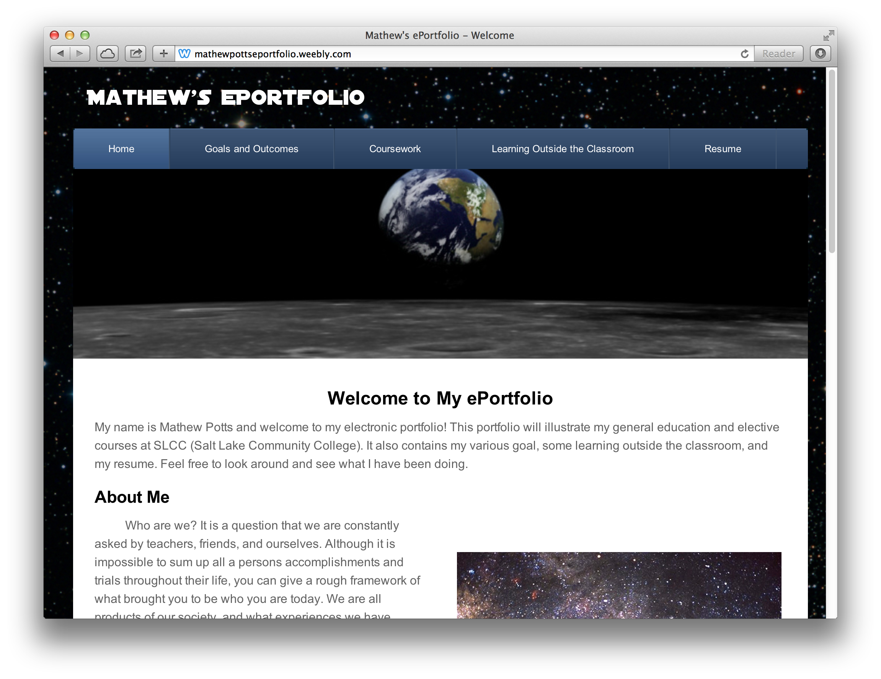
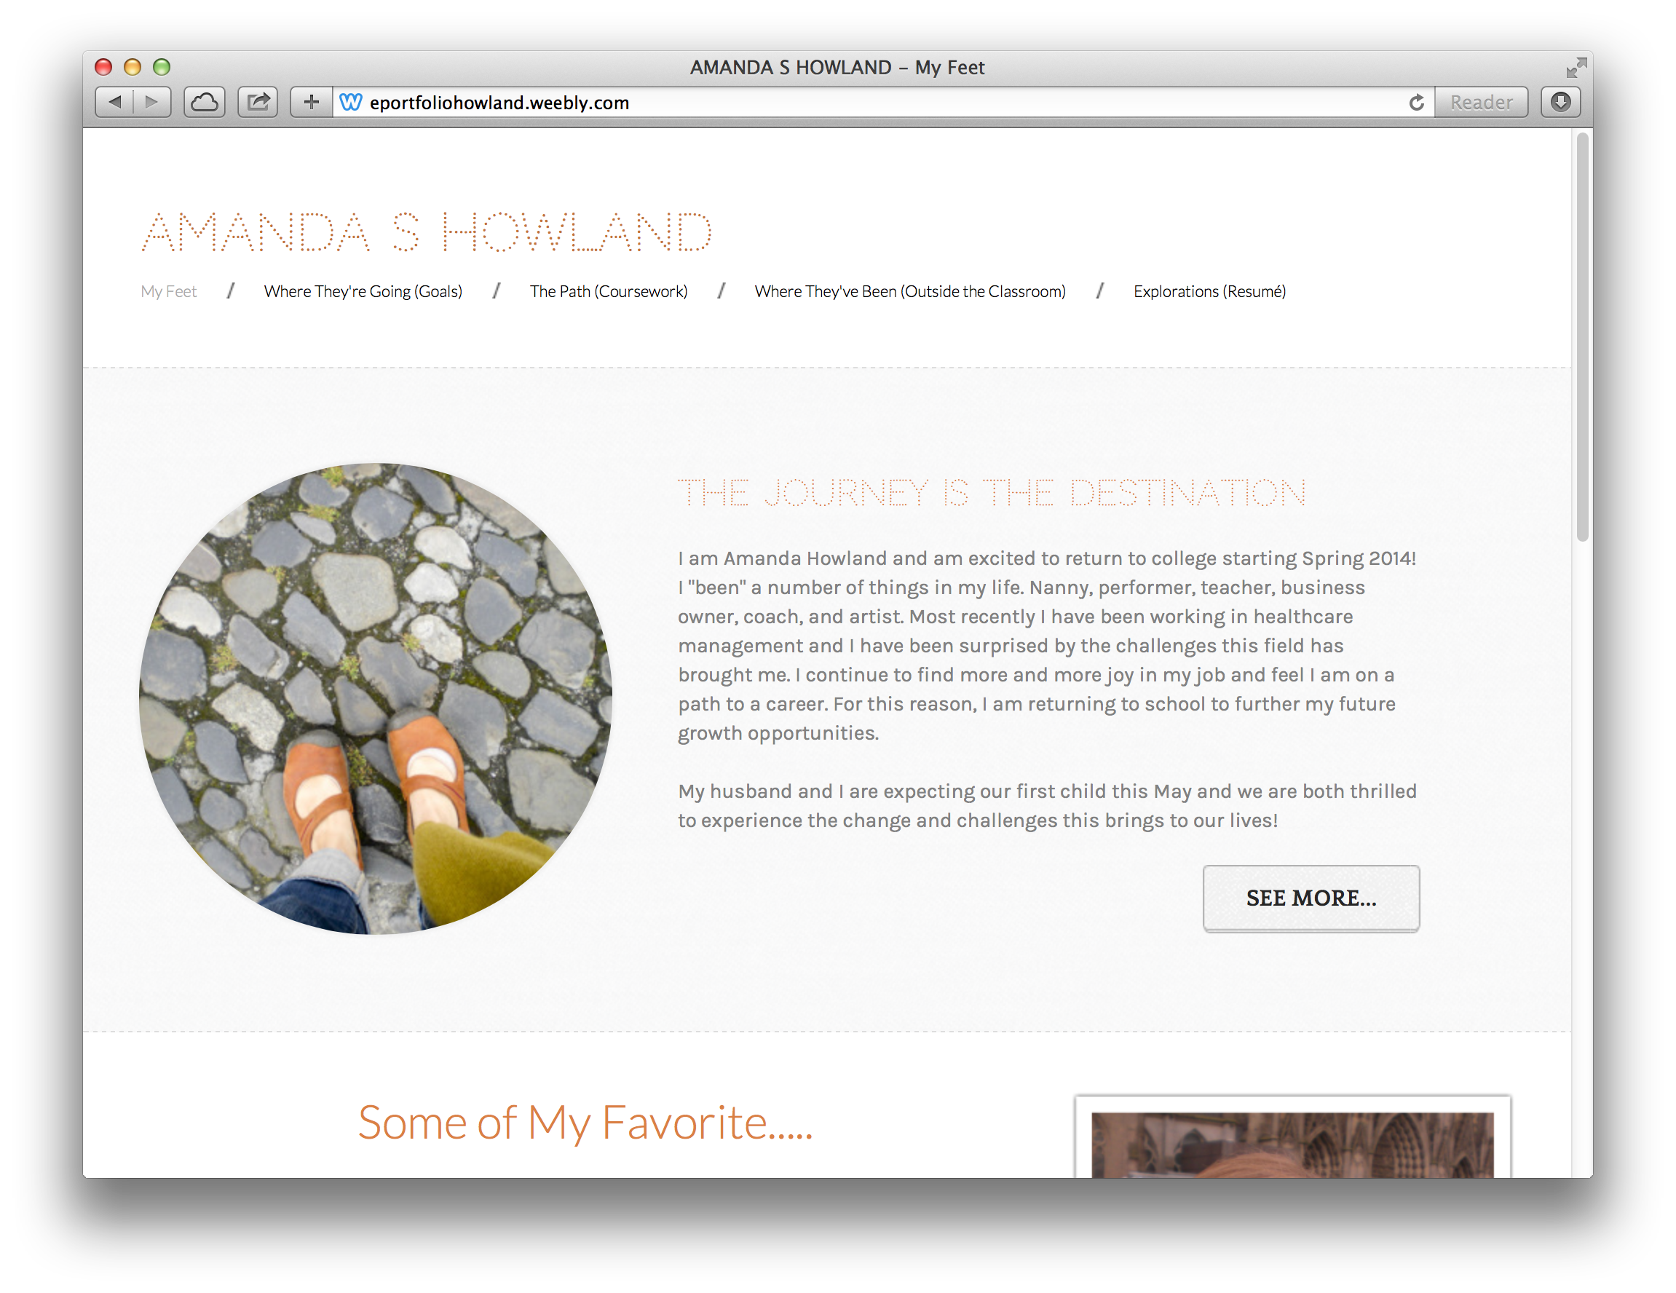
ePortfolio- A definition
http://mathewpottseportfolio.weebly.com/
http://eportfoliohowland.weebly.com/
An ePortfolio is an electronic collection of artifacts curated and owned by a student, commonly including artifacts (text, images, video) from courses or other activities, self-reflection, goals, a resume, certifications and other accomplishments, and other student or program determined elements.

Slide 4
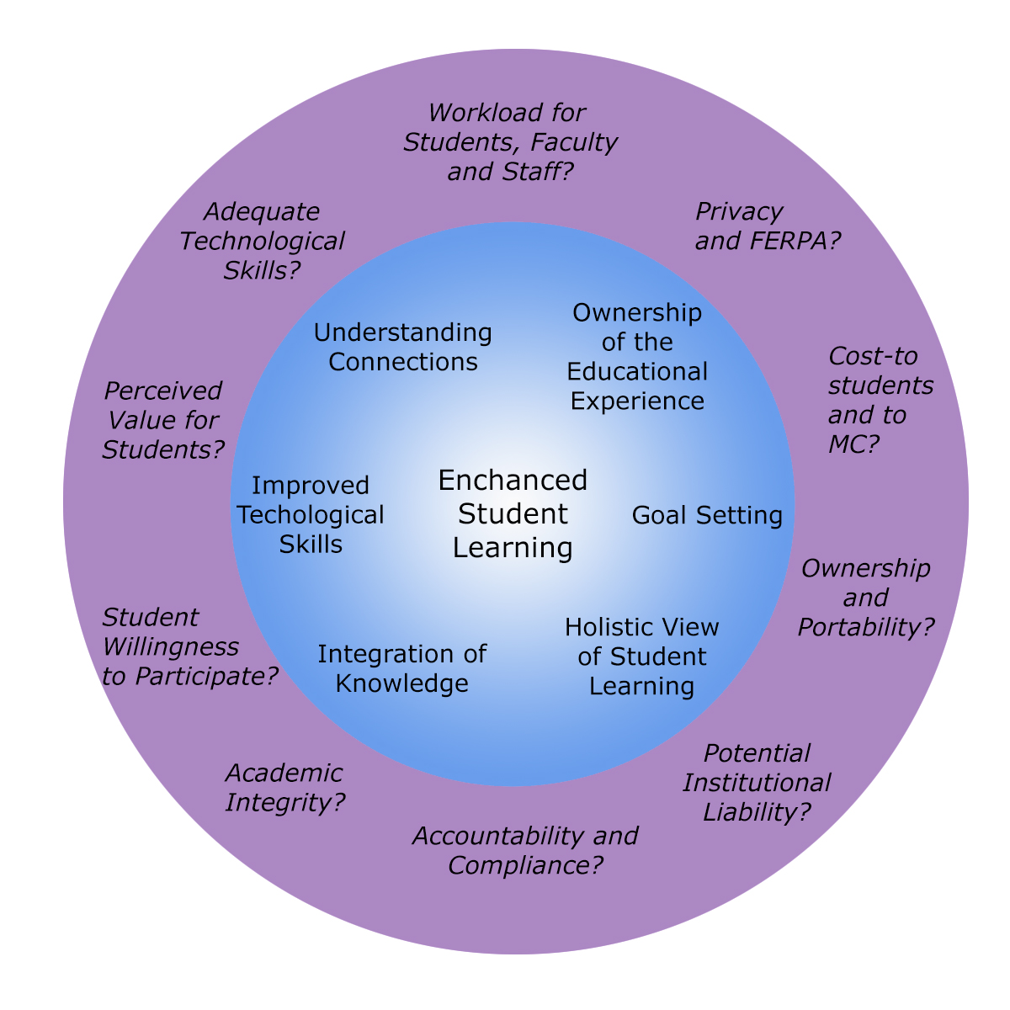
Goals for using ePortfolios
Concerns about using ePortfolios

Slide 5
Why use ePortfolios?
Improve learning outcomes (deep learning/synthesis/new connections/create new knowledge)
Create a cohesive learning experience (program)
Integrate knowledge across disciplines and experiences
Encourages ownership and engagement in educational experience
Foster intentionality and goal setting

Slide 6
Why use ePortfolios?
Develop digital skills (digital citizenship, technical skills and digital literacy)
Create portable, evolving record of accomplishments, skills and knowledge
Create a holistic of student for transfer and employment
Foster student’s ability to articulate a holistic view of their skills and knowledge

Slide 7
What will students to?
Create a program level portfolio (designed to be used in multiple courses) as part of a course
Choose a platform
Complete program and course specific portfolio requirements (portfolio may include more than one course)
Submit and/or share a portfolio link with instructor(s)
Complete survey feedback and/or participate in focus group
Use online support/resources and/or Libraries or Writing, Reading, and Language Center resources

Slide 8
What will faculty do?
Assign ePortfolio as a part of the course requirements (syllabus statement)
Portfolio should include
Welcome Page/About Me (Develop course specific prompts and/or give students general prompts for a welcome page and about me page)
Goals Page- course specific prompt or general prompt
Courses Page- a list of courses organized around semesters, program requirements or other method.
Any other course specific requirements
Optional pages might include: accomplishments, certifications, course list/academic plan

Slide 9
What will faculty do?
Develop a rubric/grading sheet for individual assignments or a holistic rubric (examples will be provided)
Determine timeline assignments and review staggered throughout the semester
Give students links to resource materials and student information sheet
Complete feedback survey at the end of the semester
Plan for next semester, if you choose

Slide 10
Learning Opportunities
Attend open portfolio lab-winter session
Explore different platforms
Discuss assignments, ideas or questions about eportfolios
Jan 5, RV, HU 325, 10-noon
Jan 11- GT, PK 170, 10-1 pm
Jan 20- HU 325, 10-noon

Slide 11
Learning Opportunities
Attend ePortfolio Poster Session- Jan 19, 2017 Professional Day
Participate in ePortfolio Communities of Practice meetings (2-3 in the semester)

Slide 12
Support and Resources
Online resources for selected 1st year platforms (Word Press, Weebly, Wix) (for faculty and students)
Online resources including (for Faculty):
portfolio pedagogy, sample assignments and rubrics, information and examples integrative learning, digital citizenship, teaching self-reflection (http://eportfoliomontgomerycollege.weebly.com/)
Writing, Reading, and Language Centers; Digital Learning Labs- space to work on portfolio and some support(for Students)
Campus point of contact (for faculty)

Slide 13
Goals and Assessment of Pilot
Goals
Assessment
Determine feasibility of using eportfolios
value for learning and student success, engagement and retention
Practical feasibility
Build capacity for eportfolios
Faculty and student perception (platforms/technology, value of eportfolios, ideas for using eportfolios)
Student success- Course Grades, Semester GPA, Ongoing GPA
Retention- Fall to Spring

Slide 14
Who Can Participate?
Any full or part time faculty member teaching any course
For first semester- need to be willing to experiment and figure things out
Willing to commit for full semester

Slide 15
Next Steps
Please complete the interest form and leave it with us.
Consider talking with your department chair or course coordinator
Think about how to use the portfolio in your course
Ask questions

Slide 16
Questions
Have additional questions? Want more information, want to volunteer? generalstudies@montgomerycollege.edu or samantha.veneruso@montgomerycollege.edu

